Slide 1
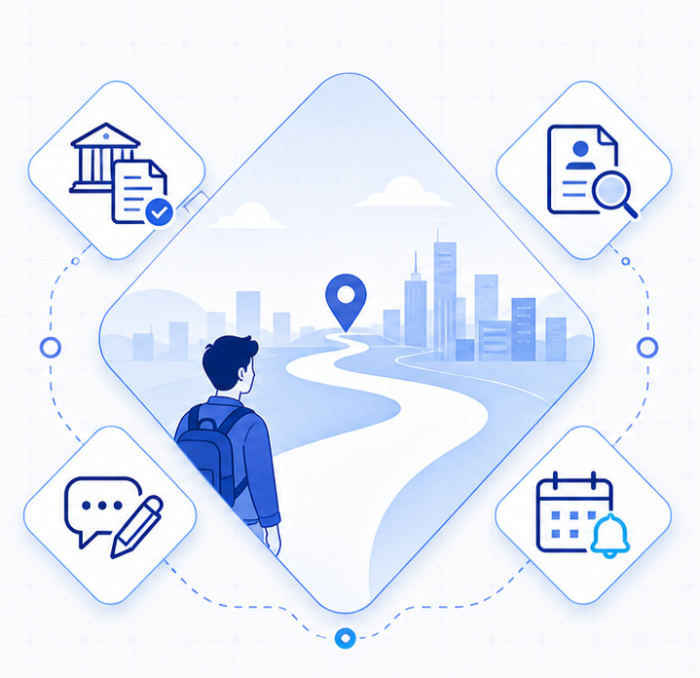
01 / 12
YouthPath
Total Assistant for Youth Career Entry
A generative AI service that connects policy matching,
job recommendations, resume coaching,
and deadline management.
Policy
Matching
Job
Search
Resume
Coaching
Schedule
Alerts
Deep Learning and Applications Project Proposal | Team aaa | 2026

Slide 2
PROBLEM | 02
Why young job seekers need
an integrated assistant
Scattered Information
Eligibility Ambiguity
Missed Deadlines
Policies, jobs, resumes, and deadlines live across separate platforms.
It is hard to quickly know which programs fit a specific profile.
Application and hiring schedules are fragmented, so opportunities are easy to miss.
Search cost increases
Personalized guidance is missing
Execution timing is lost
Proposal criterion: Problem definition and motivation

Slide 3
RELATED WORK | 03
Gaps in existing services
Service
Strength
Limitation
YouthPath Improvement
OnTong Youth
Integrated policy information
Weak personal context
Profile-based policy matching
WorkNet / JobKorea
Rich job listings
Separated from policy and schedules
Connect jobs and policies
General LLM
Natural language consultation
Unstable recency and sources
RAG-based grounded answers
Personal Calendar
Schedule management
Disconnected from opportunity search
Automatic deadline registration
Proposal criterion: Related work and differentiation

Slide 4
SOLUTION | 04
The integrated YouthPath experience
1. Policy Matching
2. Job Recommendation
Interprets eligibility rules and explains likely application fit
Recommends postings by role, region, and experience
User Profile
major · experience ·
region · target role
3. Resume & Interview Coaching
4. Calendar & Deadline Alerts
Gives role-aware feedback and improvement suggestions
Connects policy and hiring deadlines into the user schedule
Turn scattered opportunities into one actionable workflow
Proposal criterion: Solution overview

Slide 5
ARCHITECTURE | 05
System architecture
Data Sources
1
User UI
Web/app interface
Profile input
Result review
Youth
policies
2
Router /
Orchestrator
Intent classification and agent routing
Job
postings
3
Specialist
Agents
Policy Agent
Job Agent
Essay Agent
Calendar Agent
Successful
resumes
4
RAG / MCP
Data Layer
Vector search
Public API
Job API
Calendar tool
Disclosures
& news
5
Storage /
Memory
User profile
Search logs
Schedule data
Proposal criterion: System architecture

Slide 6
AGENTS | 06
Agent role design
Router Agent
Analyzes the user request and calls the needed specialist agent
1
Policy Agent
2
Job Agent
3
Essay Agent
4
Calendar Agent
Input: profile, region, income
Input: target role, experience
Input: resume draft
Input: policy and hiring deadlines
Process: eligibility matching
Process: posting filtering
Process: rubric-based feedback
Process: conflict checking
Output: applicable programs
Output: recommended openings
Output: edits and interview questions
Output: calendar events and alerts
Each agent can run independently, while results are integrated around the user goal
Proposal criterion: Agent design

Slide 7
TECH APPROACH | 07
Why a RAG and MCP-based approach
Project Condition
Technical Choice
Expected Effect
User Query
Policy and job data
changes constantly
RAG-based runtime
retrieval
Grounded answers with
current sources
Retrieve
External APIs and
tools are required
MCP / Tool Calling
Connect public data
and calendars
Agent
Credits and
training cost are limited
Lightweight
orchestration
Fast prototype
without retraining
Answer with
Sources
Solve the problem by connecting current data and tools, not by retraining a model.
Proposal criterion: Technical approach and rationale

Slide 8
DATA | 08
Dataset and processing strategy
Data Source
Purpose
Update Method
Processing Strategy
Youth policy data
Policy matching and eligibility
Public API / scheduled crawl
Normalize condition fields
Job postings
Role and region recommendations
Job API / RSS
Tag roles and skills
Successful resume examples
Feedback criteria
Curated public material
Chunk by prompt and competency
Evaluation rubrics
Resume and interview coaching
Course rubric and guides
Convert to prompt rules
Disclosures and news
Company context enrichment
Search and disclosure links
Source-based summaries
Use only public data with checked licenses and privacy constraints.
Proposal criterion: Dataset and processing strategy

Slide 9
EVALUATION | 09
Experiment and evaluation plan
Quantitative Evaluation
Qualitative Evaluation
1
2
3
4
5
Policy Match
Accuracy
Source
Agreement
Response
Time
Resume Feedback
Quality
User
Satisfaction
Fit between user profile and recommended policies
Consistency between answer evidence and source conditions
Latency for practical conversational use
Specificity, role relevance, and actionability
Ease of exploration and intent to reuse
Baseline: single LLM answer
vs.
YouthPath RAG + Agent answer
Proposal criterion: Evaluation plan

Slide 10
ROADMAP | 10
Execution plan and role split
1
Proposal Presentation
2
Data Collection
and Indexing
3
Prototype
Integration
4
Evaluation and
Final Presentation
Confirm problem and design
Build policy, job, and resume corpora
Connect Agent, RAG, and UI
Improve with quantitative and qualitative tests
Policy Data
Job Data
Resume and
Evaluation
UI and Testing
Deployment and
Integration
Link policy APIs and normalize condition fields
Connect job APIs and tag roles and skills
Collect resumes and build rubrics
Implement UI and conduct usability tests
Deploy services and integrate modules
Split weekly deliverables into small pieces to manage credit use and debugging risk.
Proposal criterion: Implementation plan and team roles

Slide 11
IMPACT | 11
Expected impact and risk response
Expected Impact
Risk Response
Risk
Response Strategy
Shorter search time
Policies, jobs, and deadlines in one place
Credit exhaustion
Caching, free tiers, summary-first processing
Fewer missed policies
External data instability
Prioritize public APIs and preserve source links
Eligibility conditions and deadlines shown together
Long documents and debugging
Chunking and module-by-module tests
More efficient job preparation
Recommendations, feedback, and scheduling linked to action
Privacy concerns
Minimal collection and local storage options
The goal is not to build every feature big, but to connect the real user workflow end to end.
Proposal criterion: Impact and risk management

Slide 12
END | 12
Q & A
Q and A
An integrated AI assistant for fragmented youth career-entry information
Policy matching, job recommendations, resume coaching, schedule management
Validated through a prototype and evaluation dataset
YouthPath | Deep Learning and Applications Project Proposal

